Slide 1
ON THE MOVE IN EUROPE
Towards a Democratic and Multicultural Society

Slide 2
First Meeting Igualada
March 2017

Slide 3
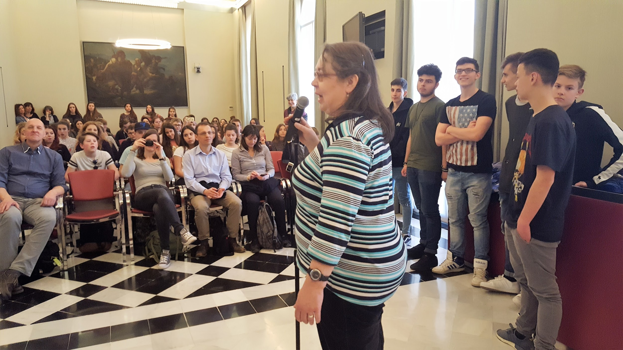
Igualada’s Townhall

Slide 4
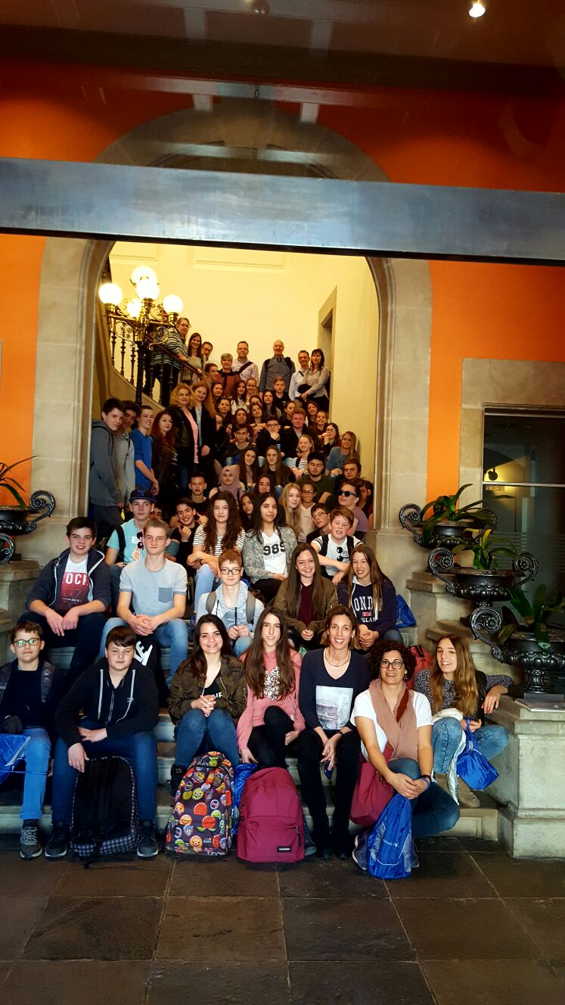
Igualada’s Townhall

Slide 5
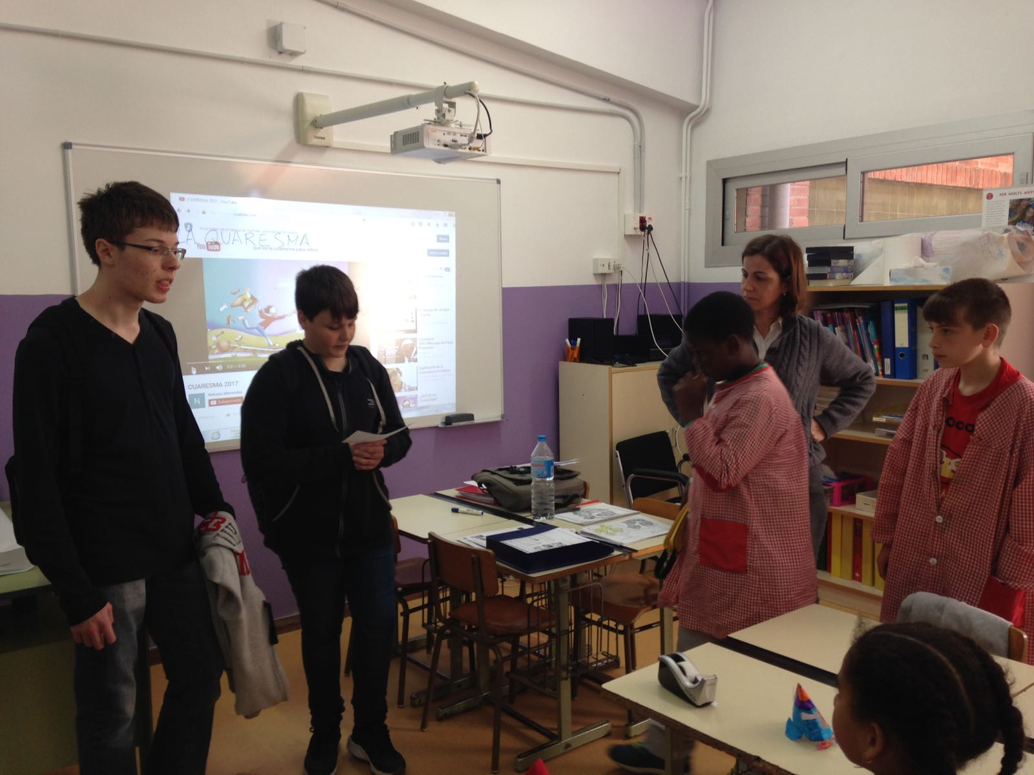
Visit to
Gabriel Castellà

Slide 6
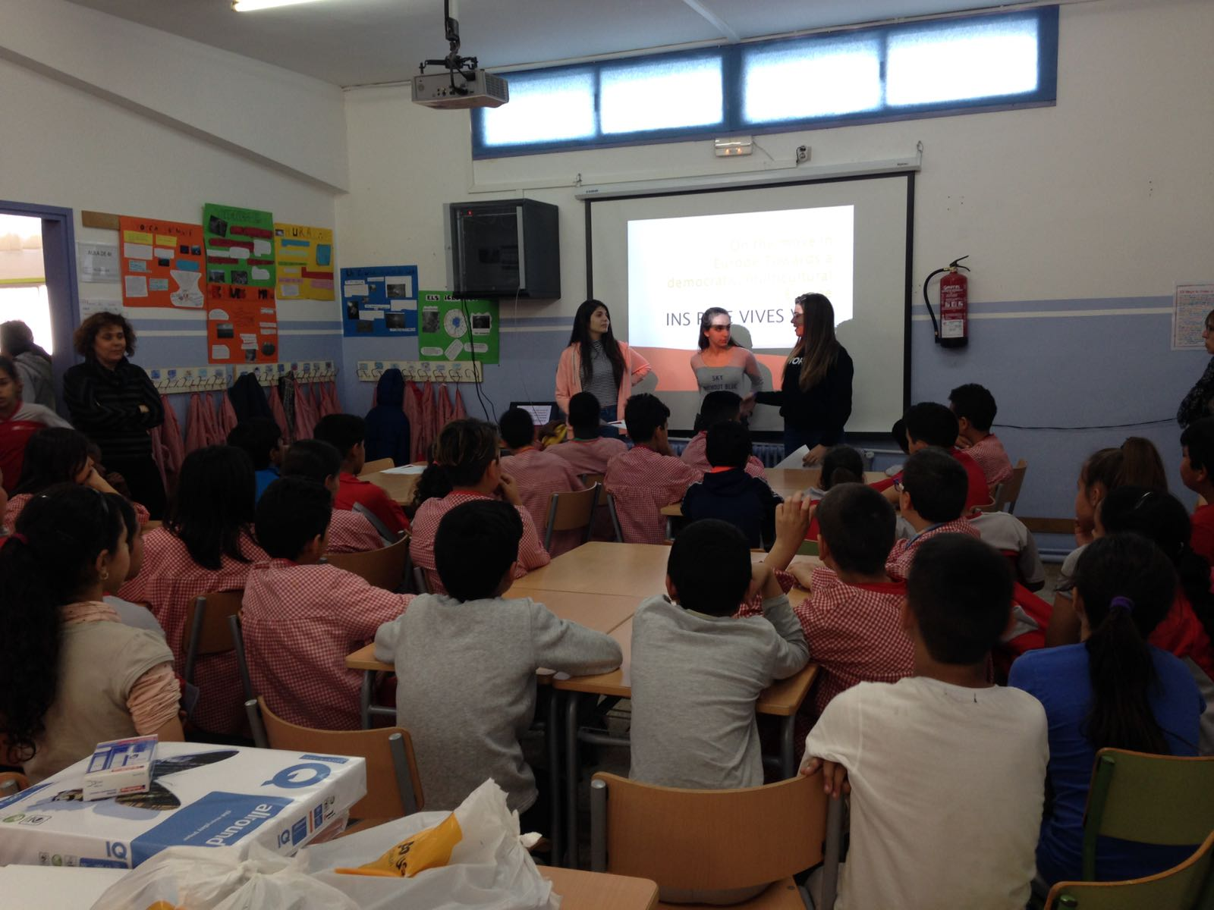
Visit to
Gabriel
Castellà

Slide 7
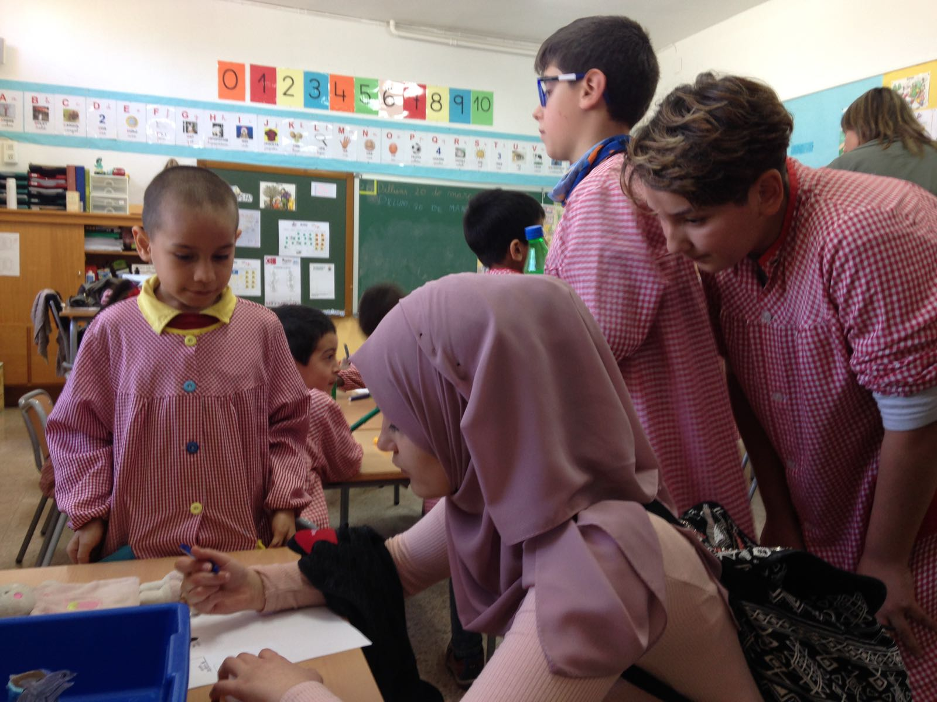
Visit to
Gabriel
Castellà

Slide 8
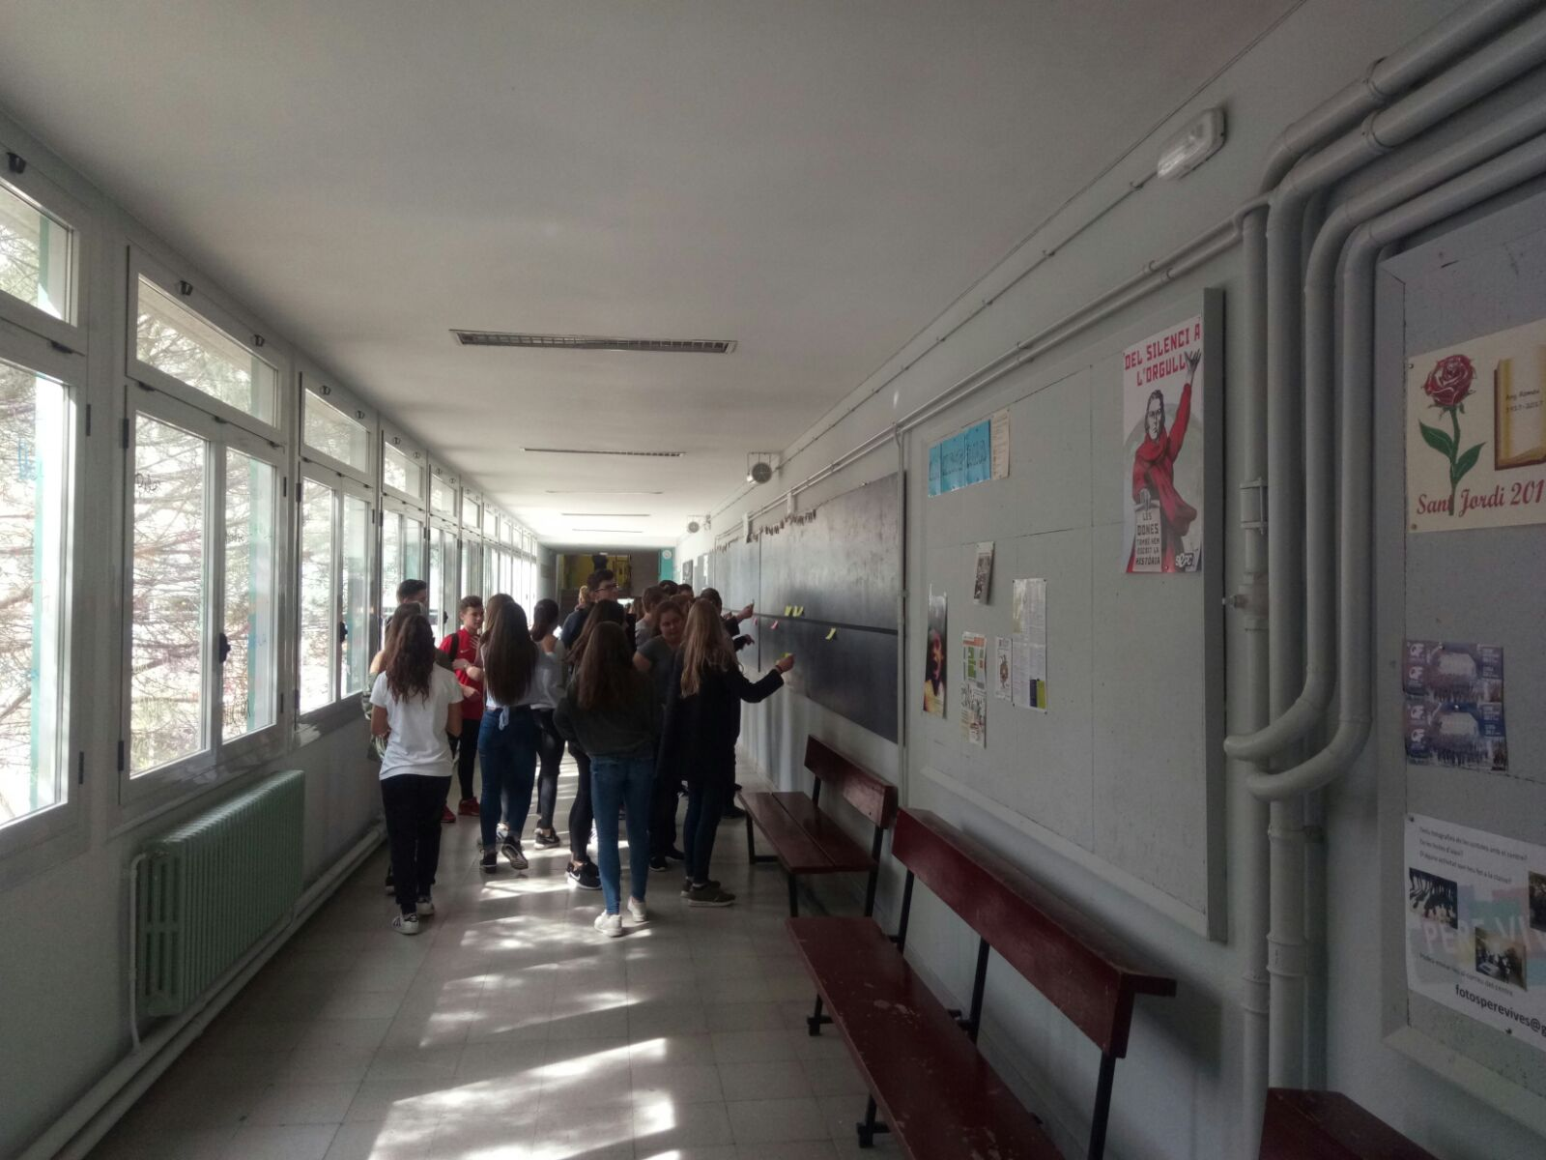
B
U
I
L
D
I
N
G
U
P
T
H
E
T
I
M
E
L
I
N
E

Slide 9
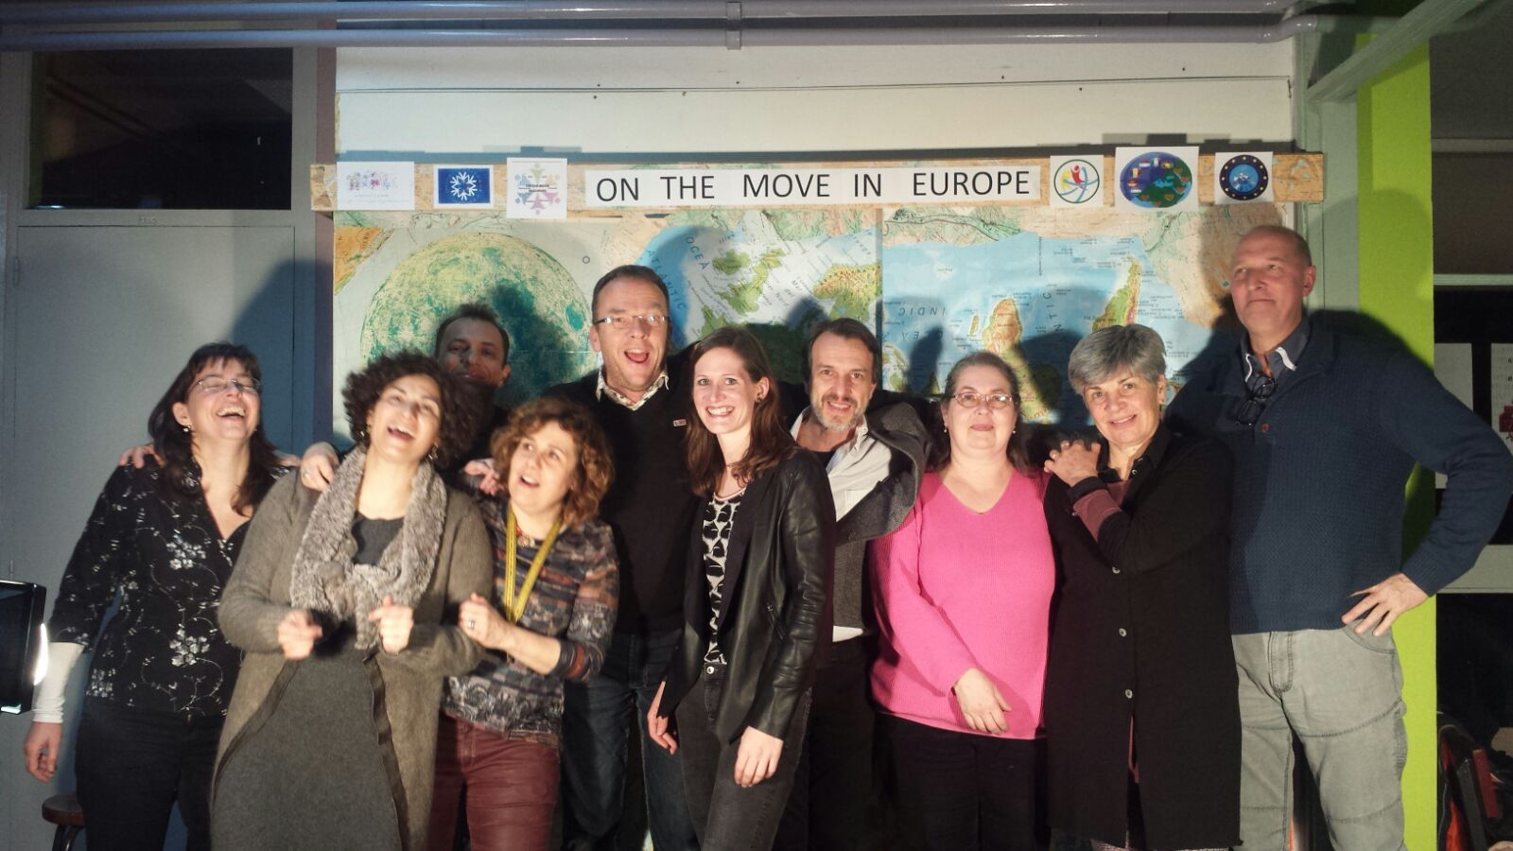
Teachers on the move

Slide 10
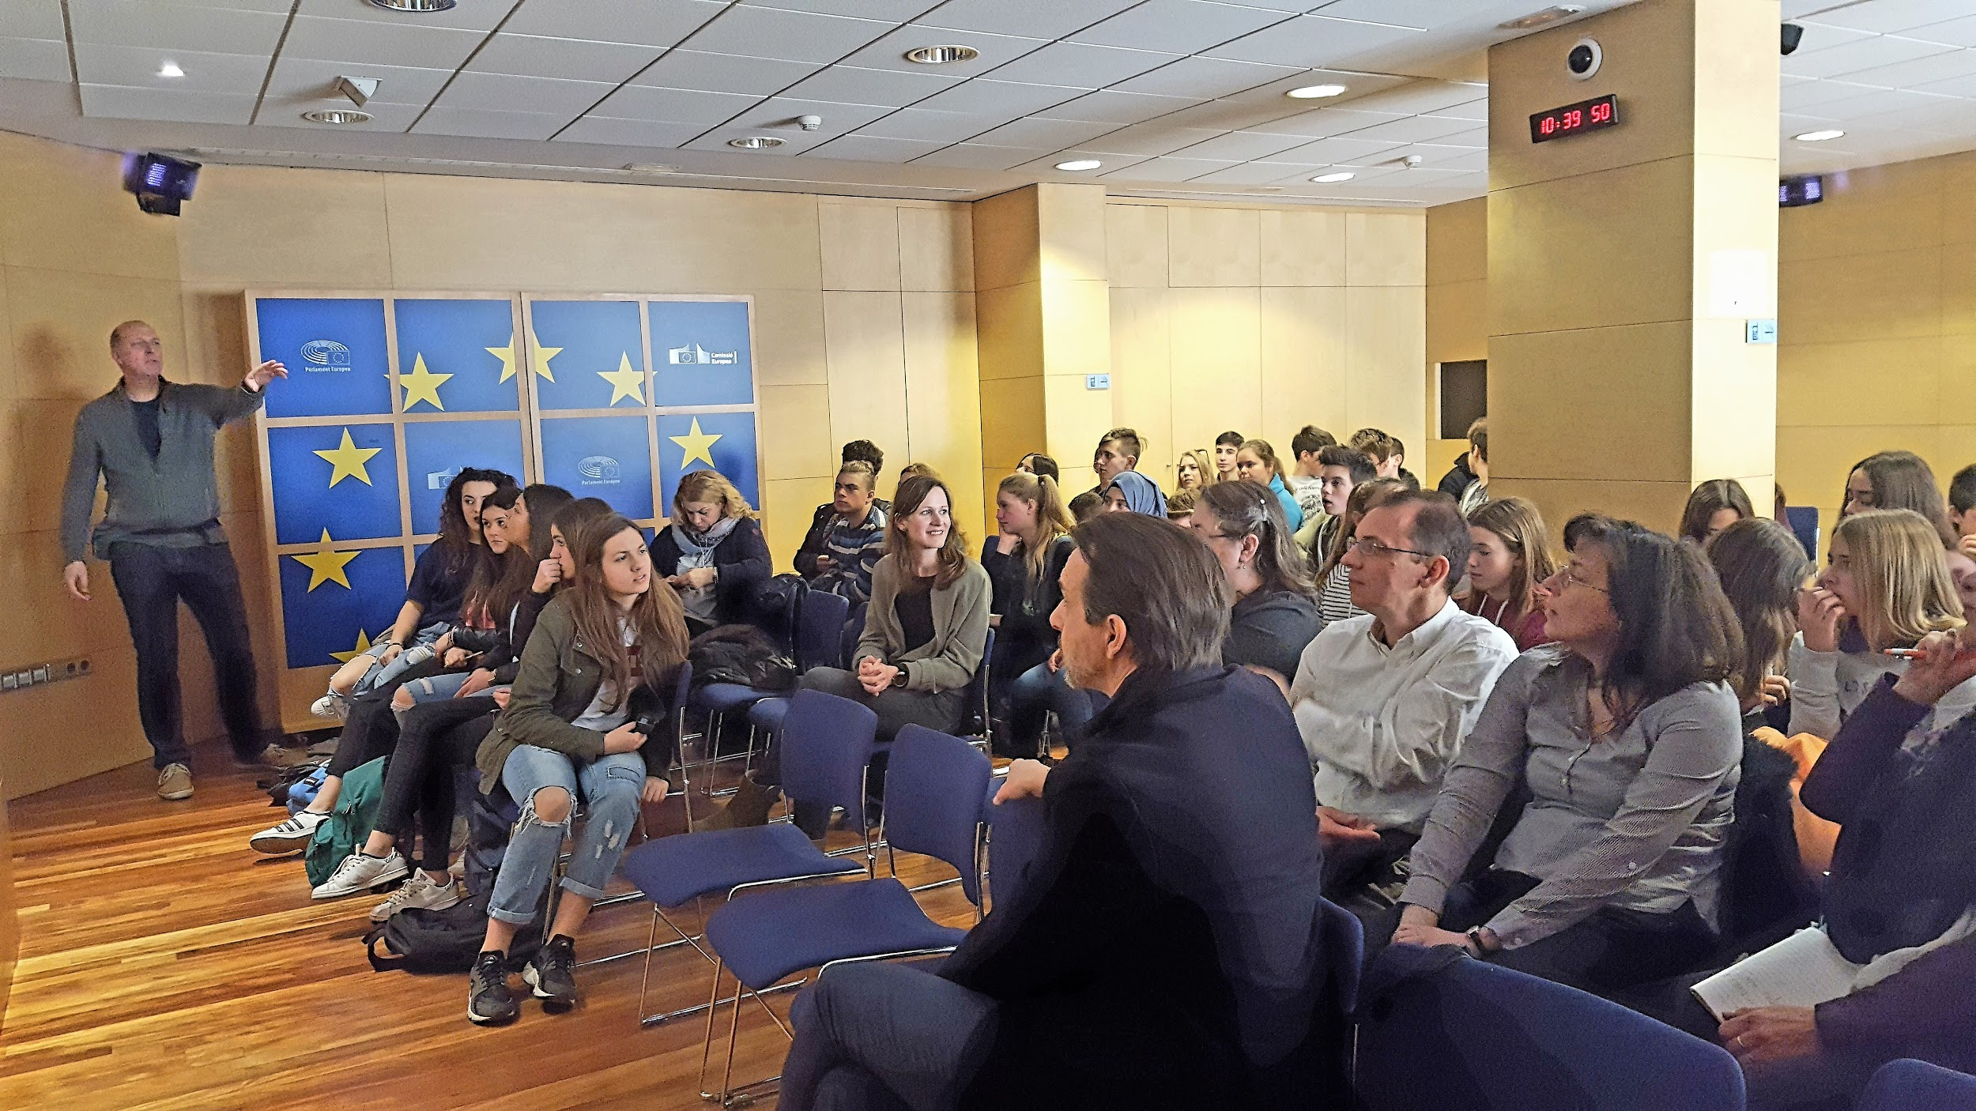
EU office in Barcelona

Slide 11
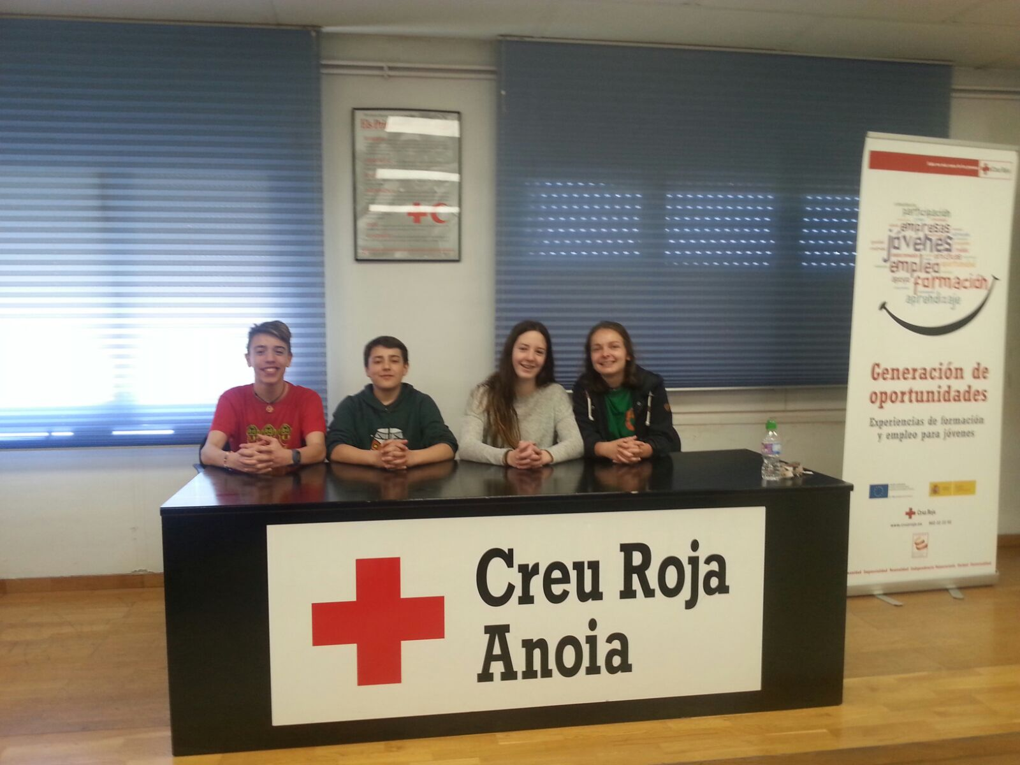
The Red Cross conference

Slide 12
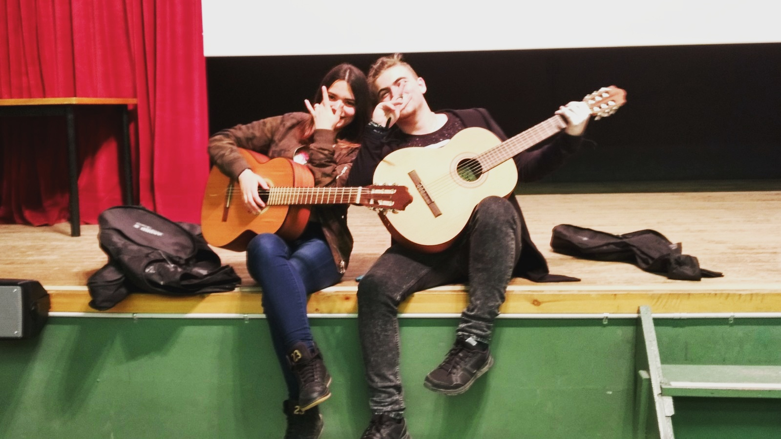
Performance in Pere Vives

Slide 13
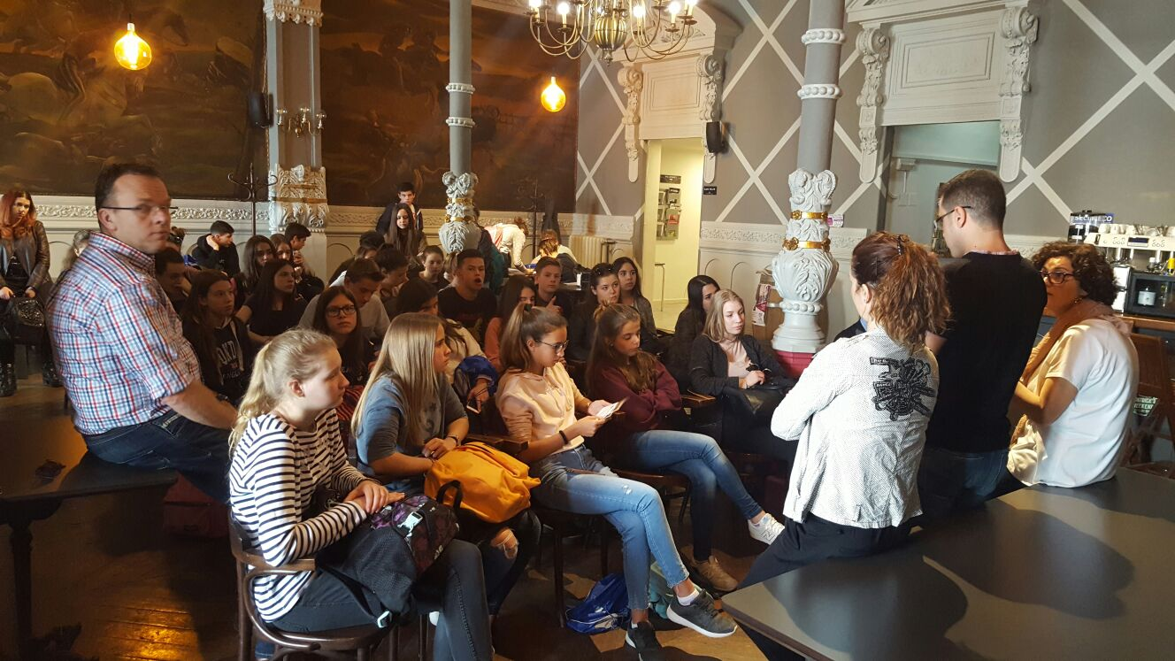
#volem acollir - Syrian refugee’s talk

Slide 14
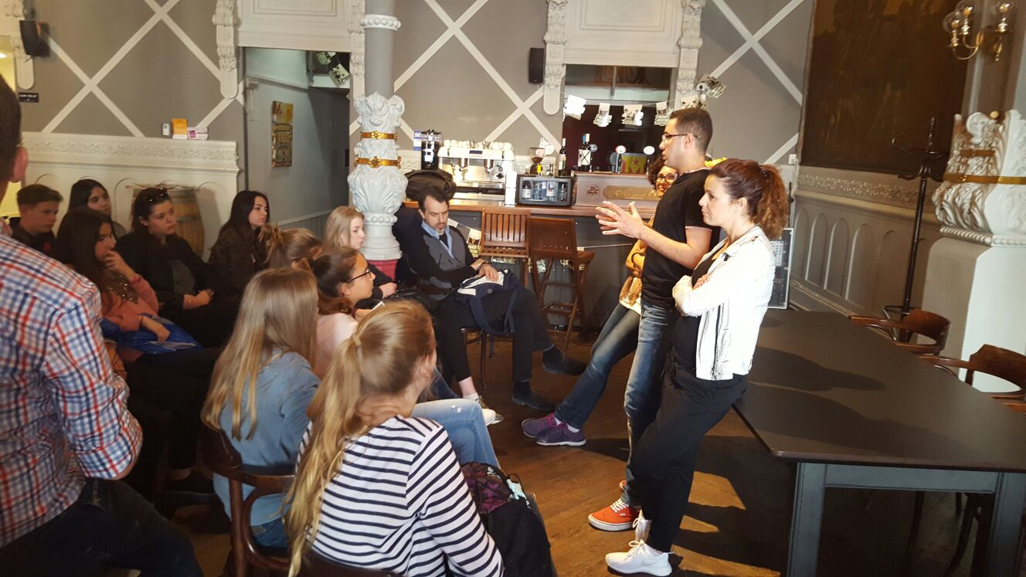
#volem acollir - Syrian refugee’s talk

Slide 15
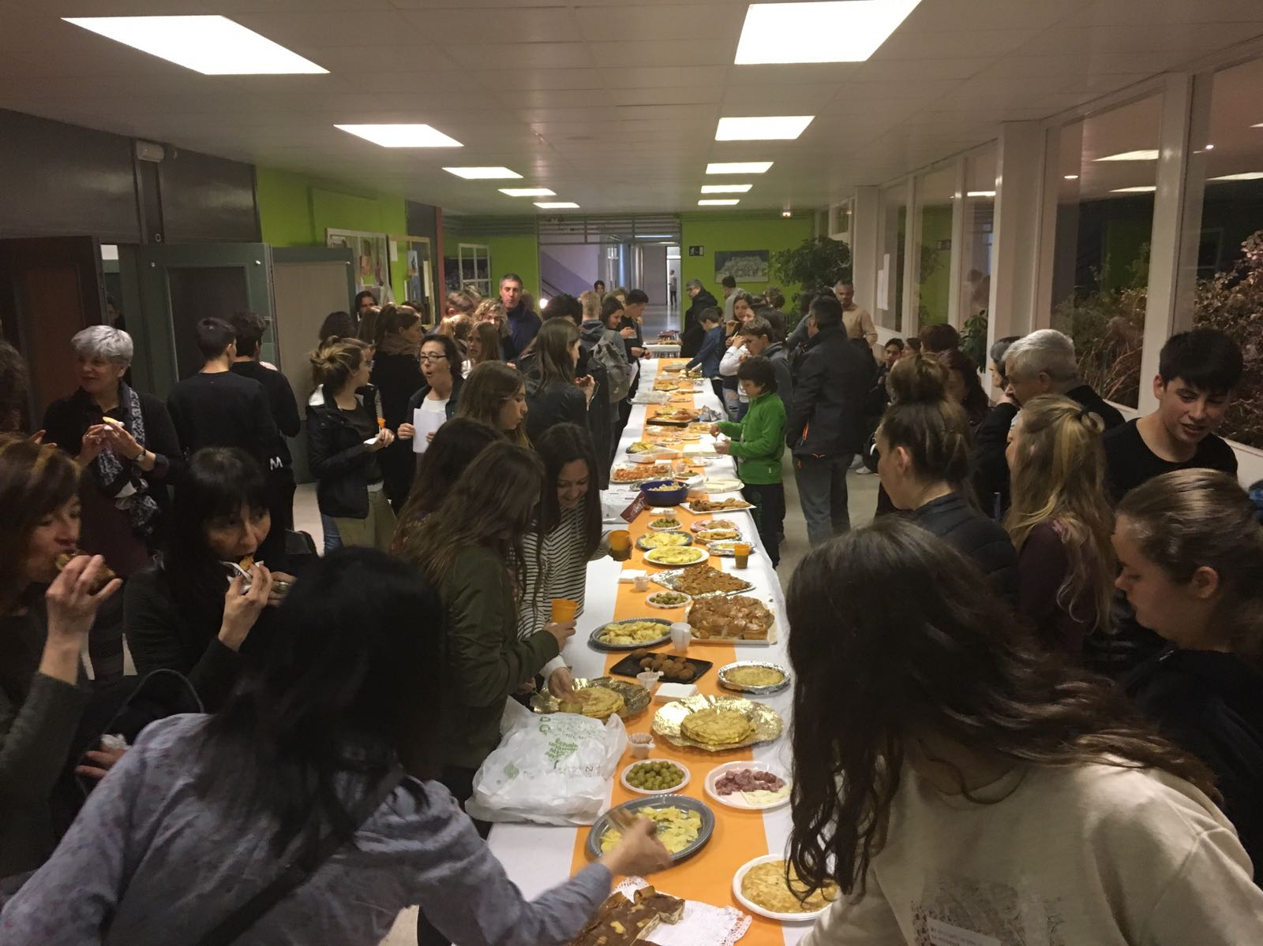
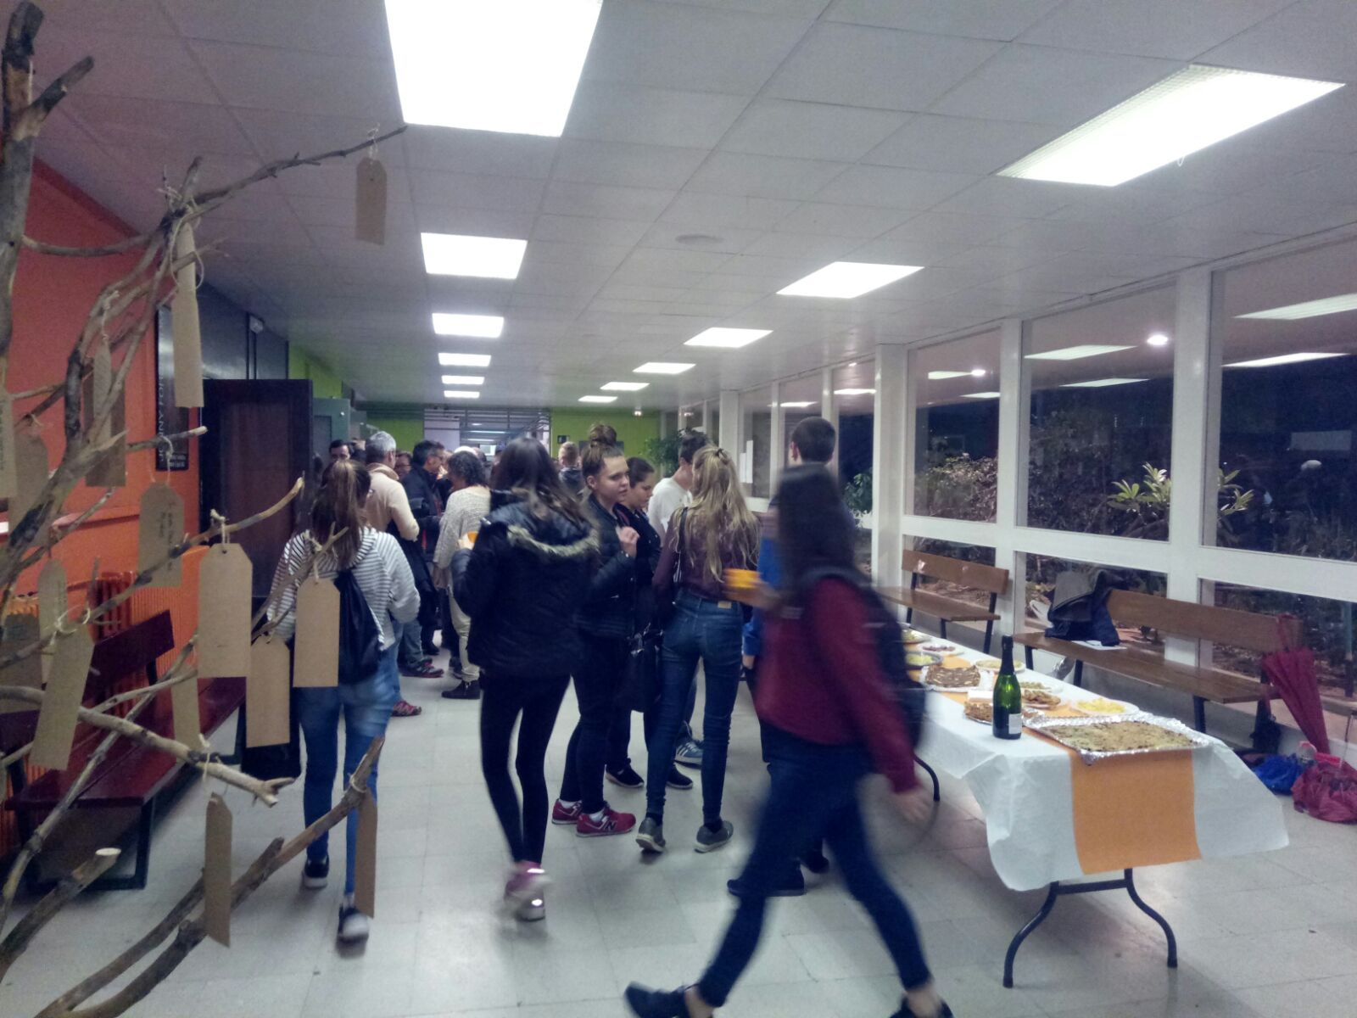
Closing dinner with families + wishes tree

Slide 16
Second Meeting Harderwijk
-Holland- November 2017

Slide 17
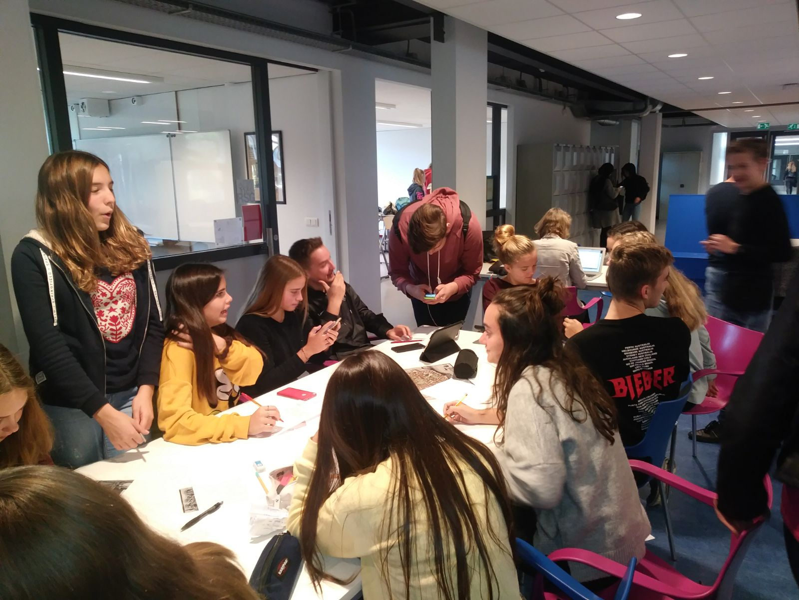
Working out the refugees’ project

Slide 18
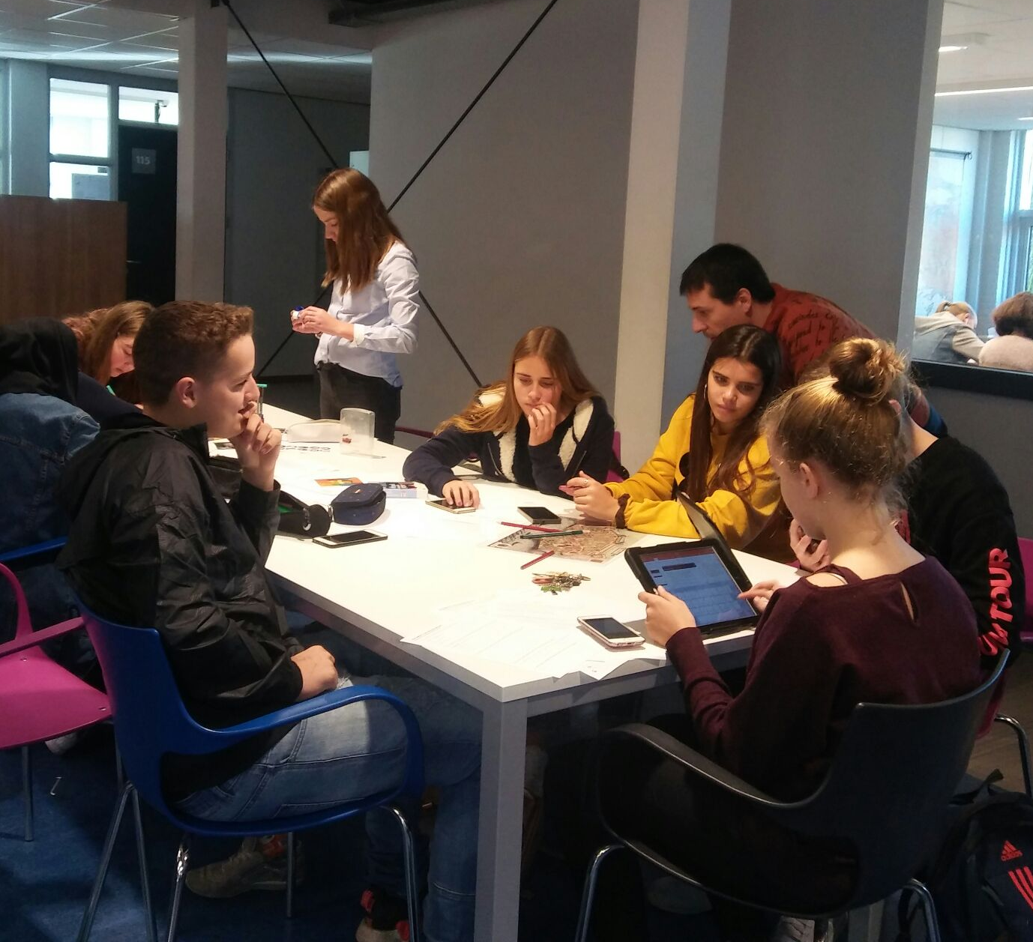
Working in groups

Slide 19
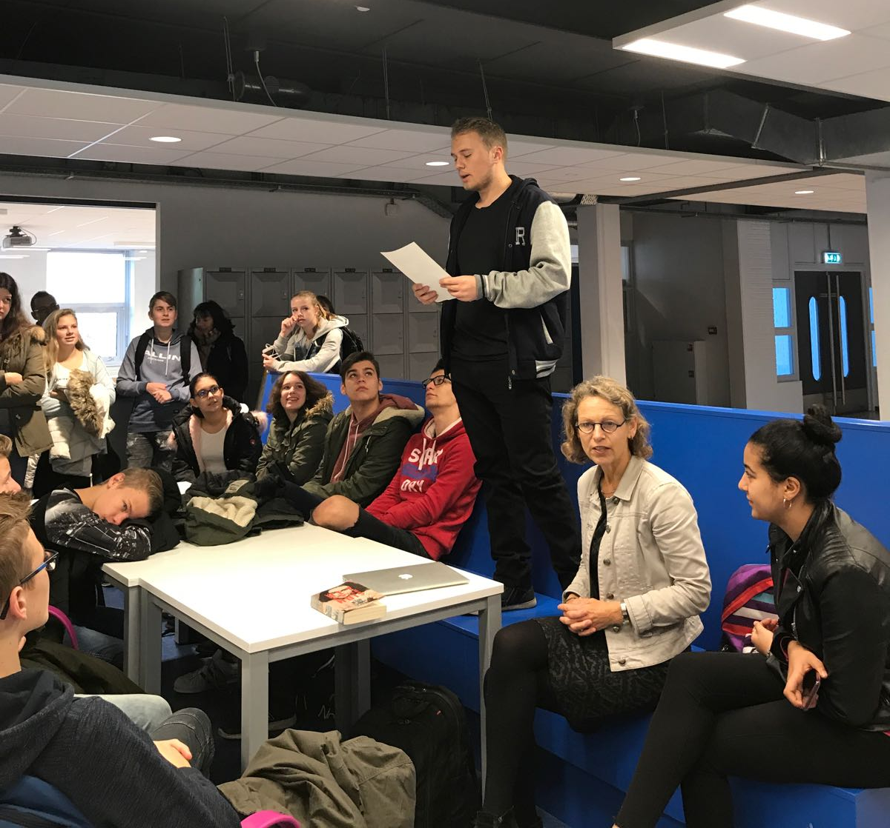
Reading Anna Frank’s letter

Slide 20
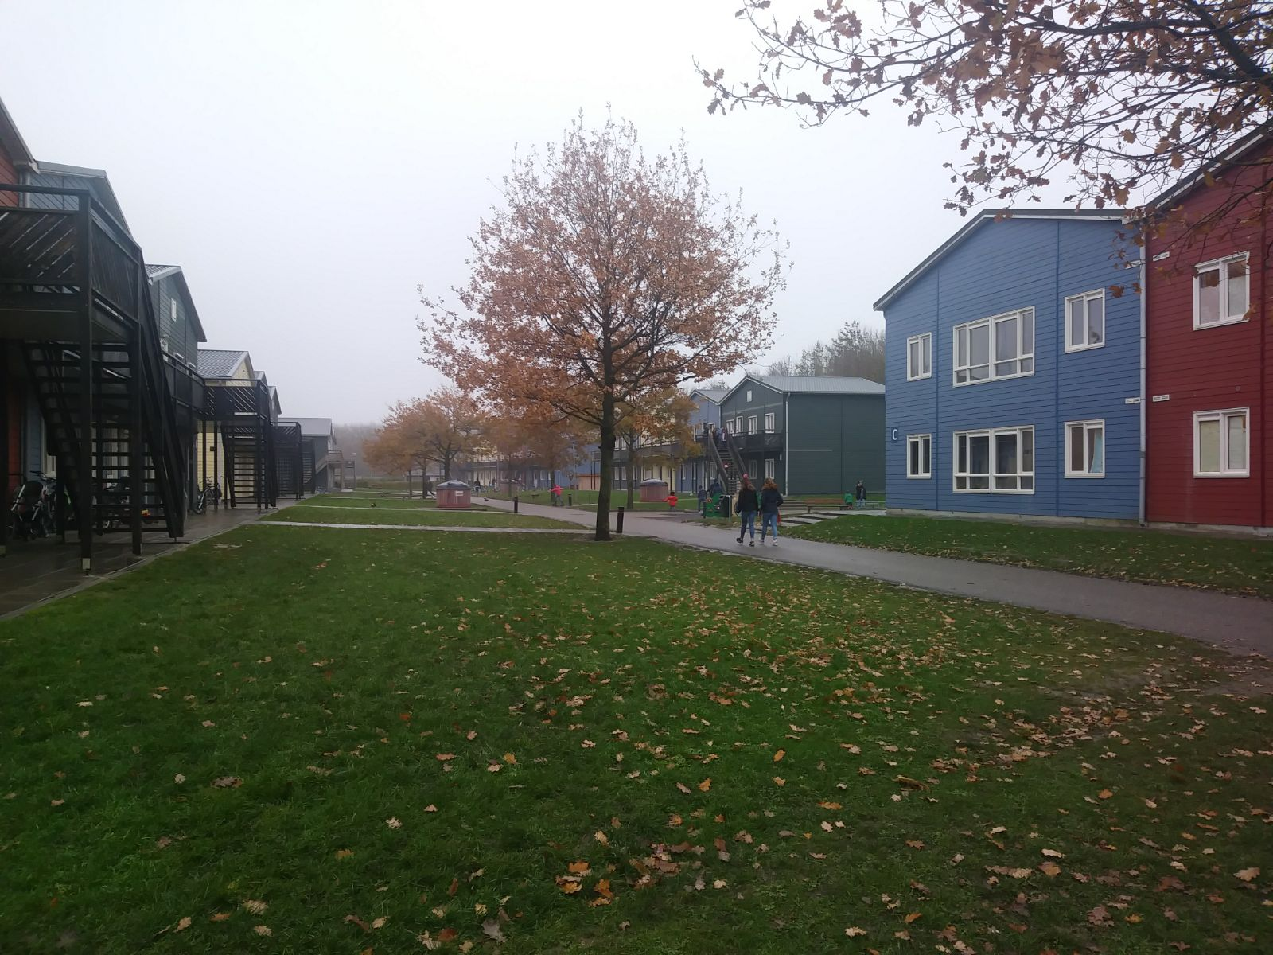
Refugees’ centre in Zeewolde - 400 refugees -

Slide 21
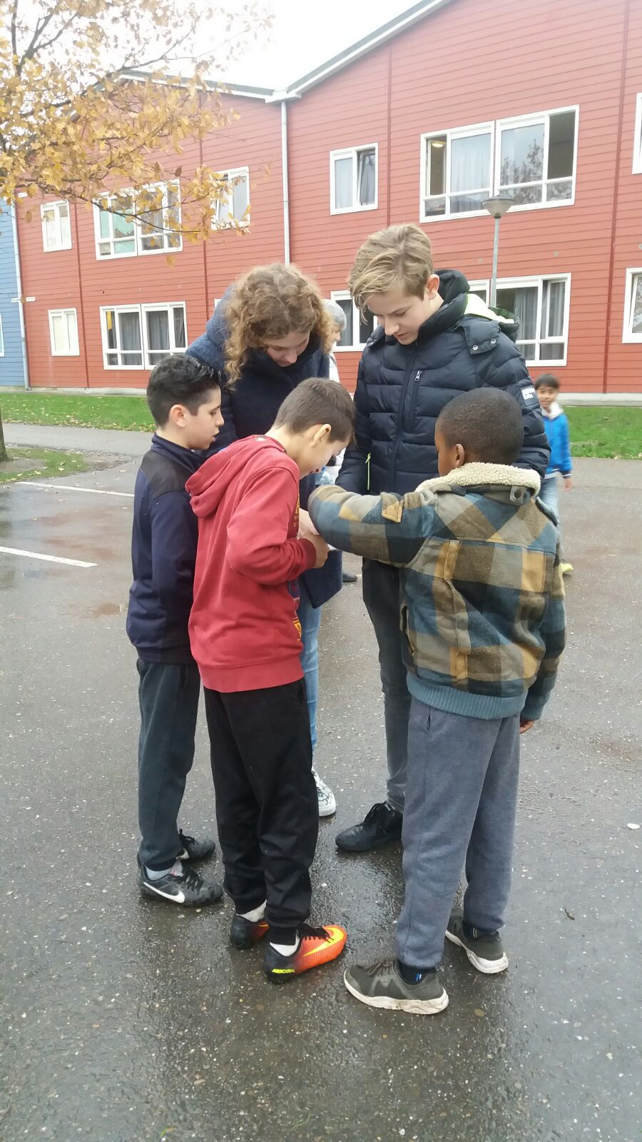
Talking with some refugee children

Slide 22
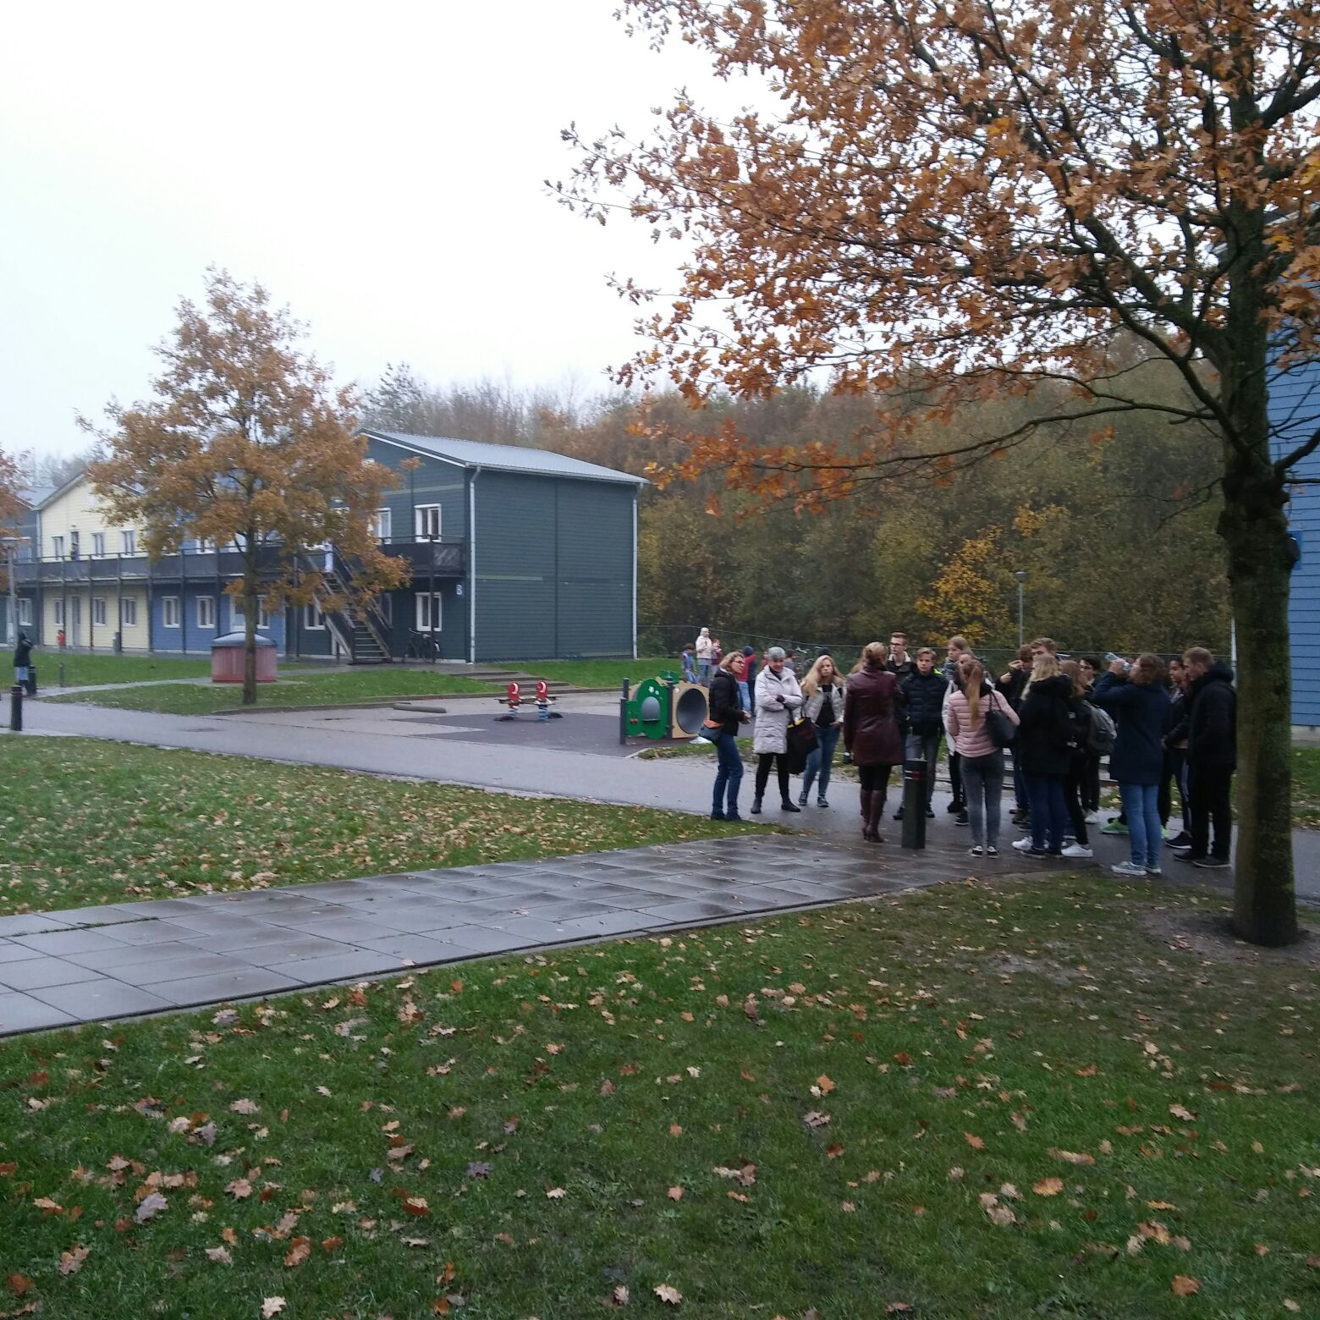
Visiting the refugee centre

Slide 23
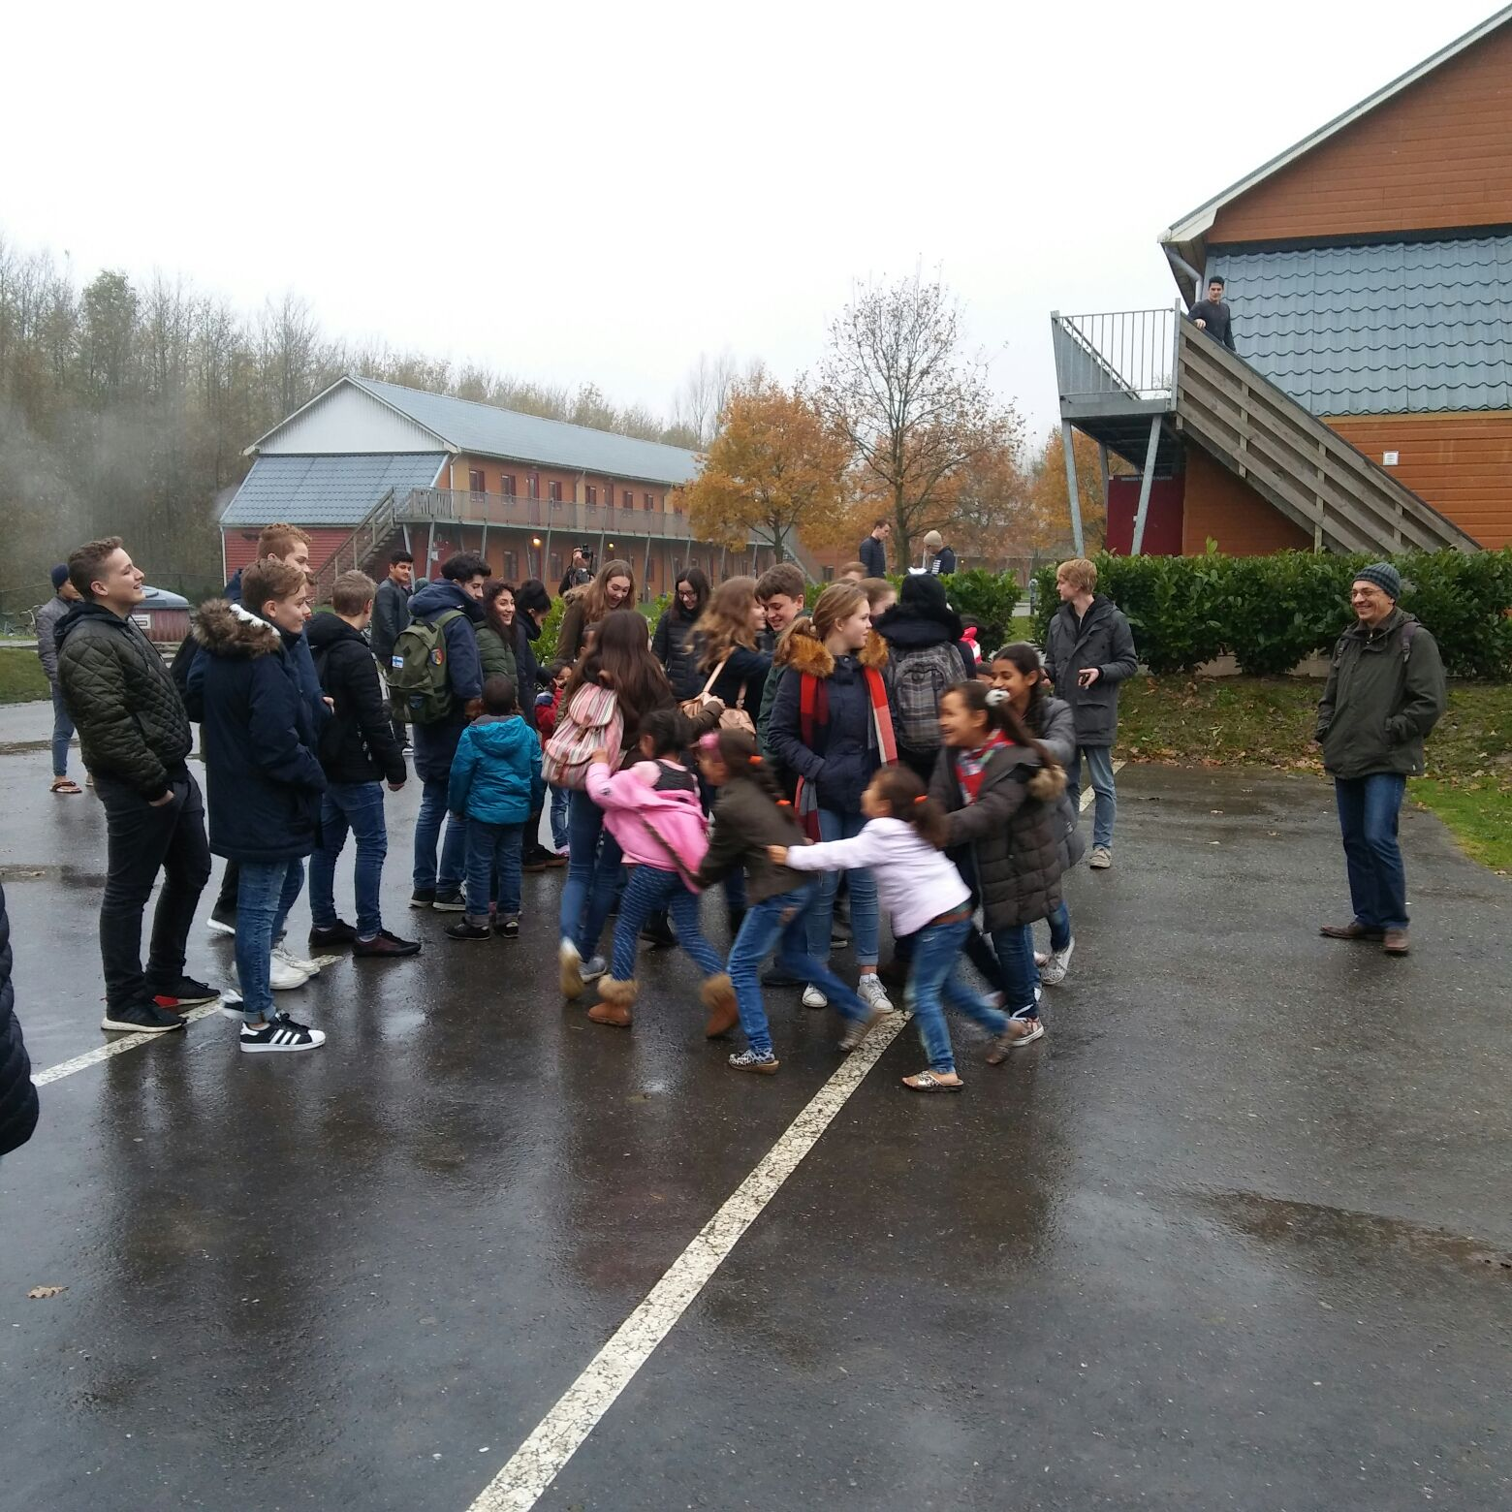
Playing with refugee children

Slide 24
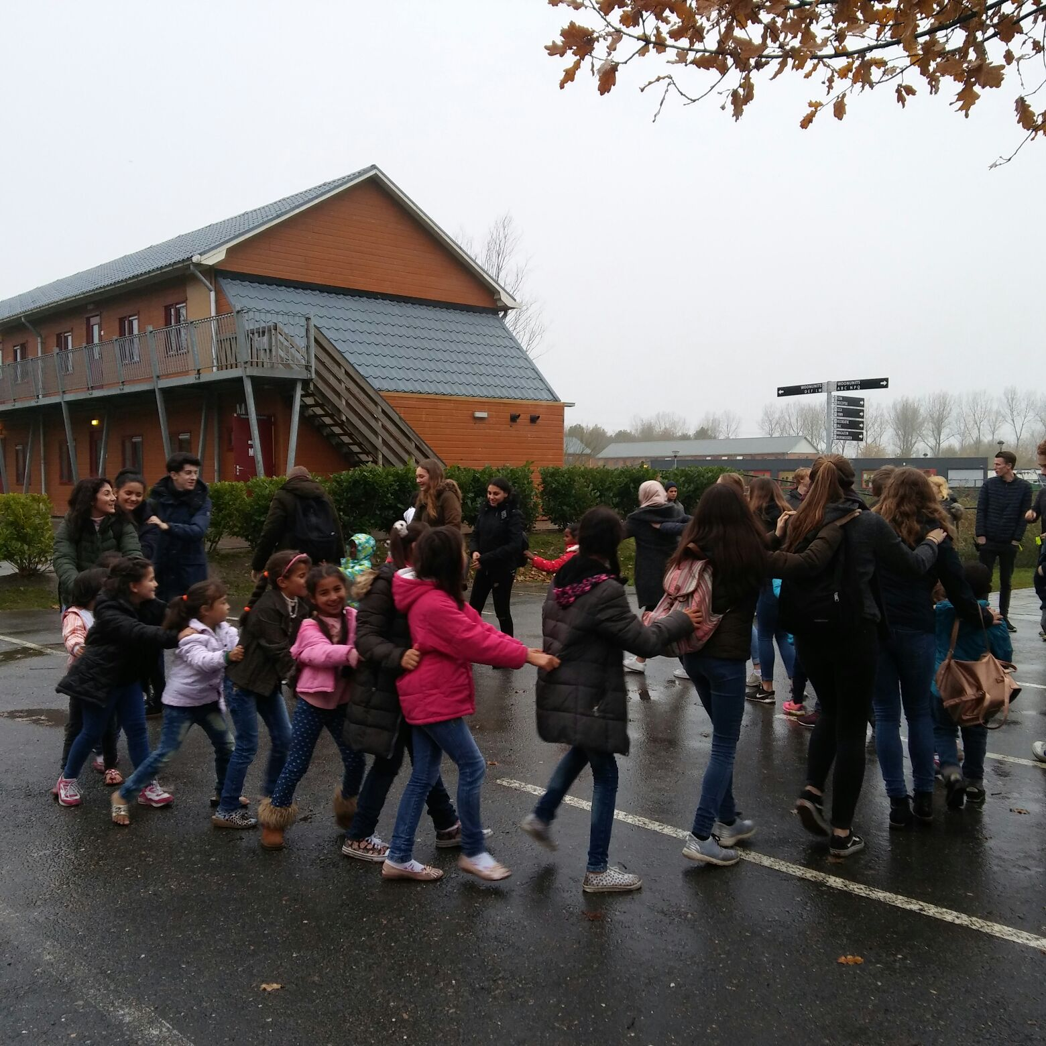
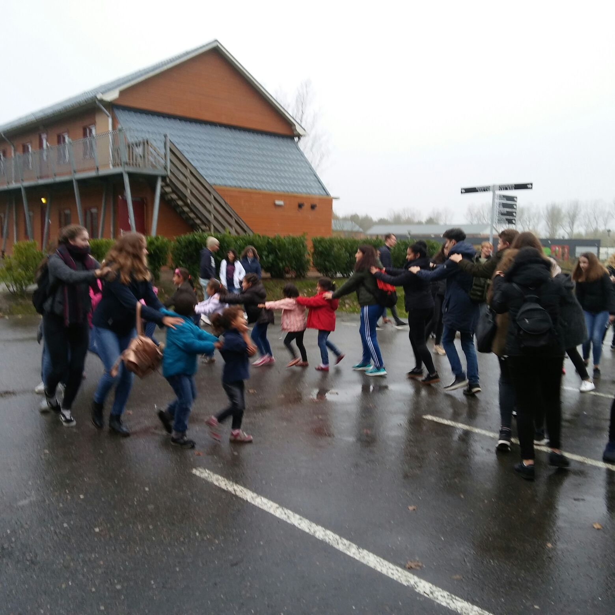
Dancing with refugee children

Slide 25
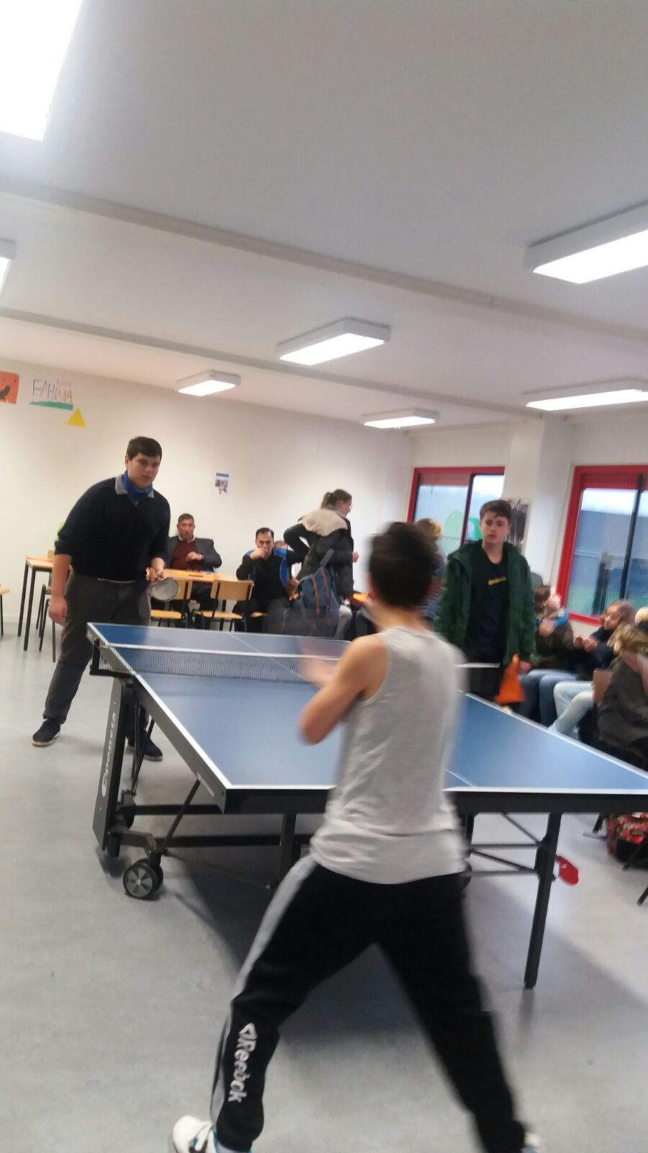
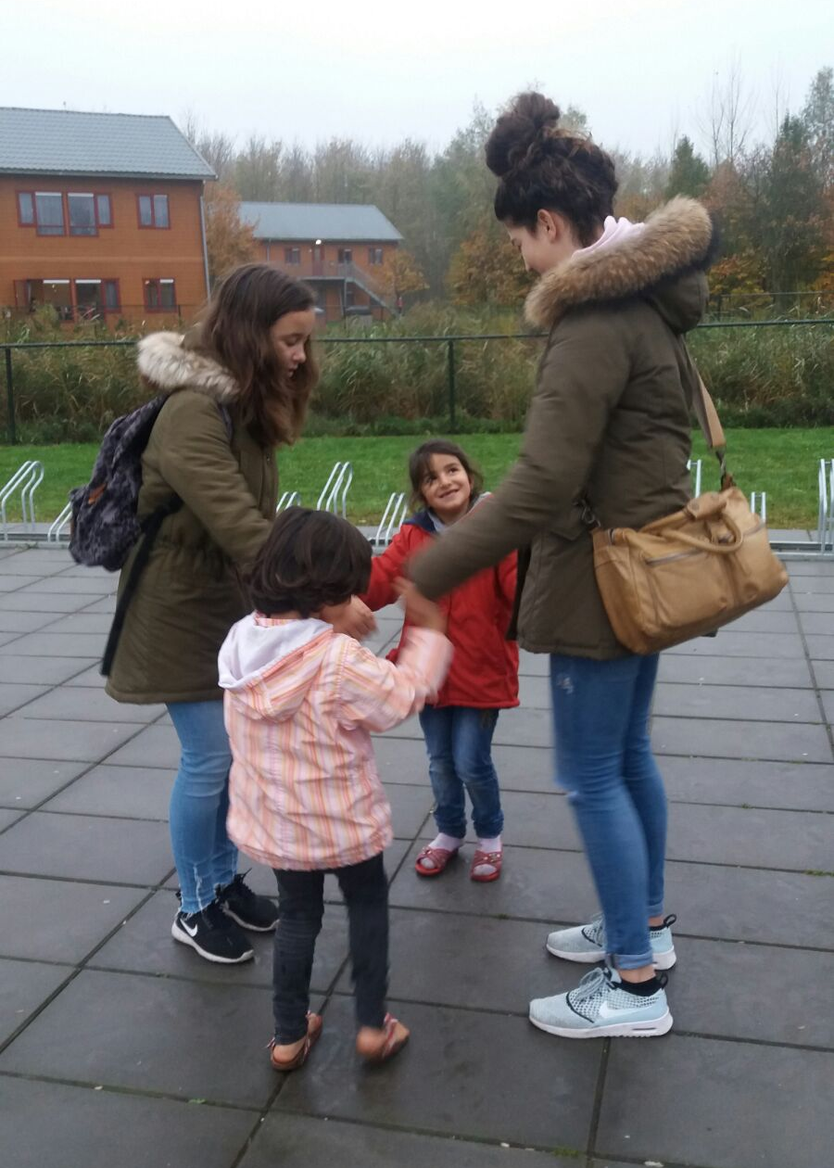
Playing with refugees

Slide 26
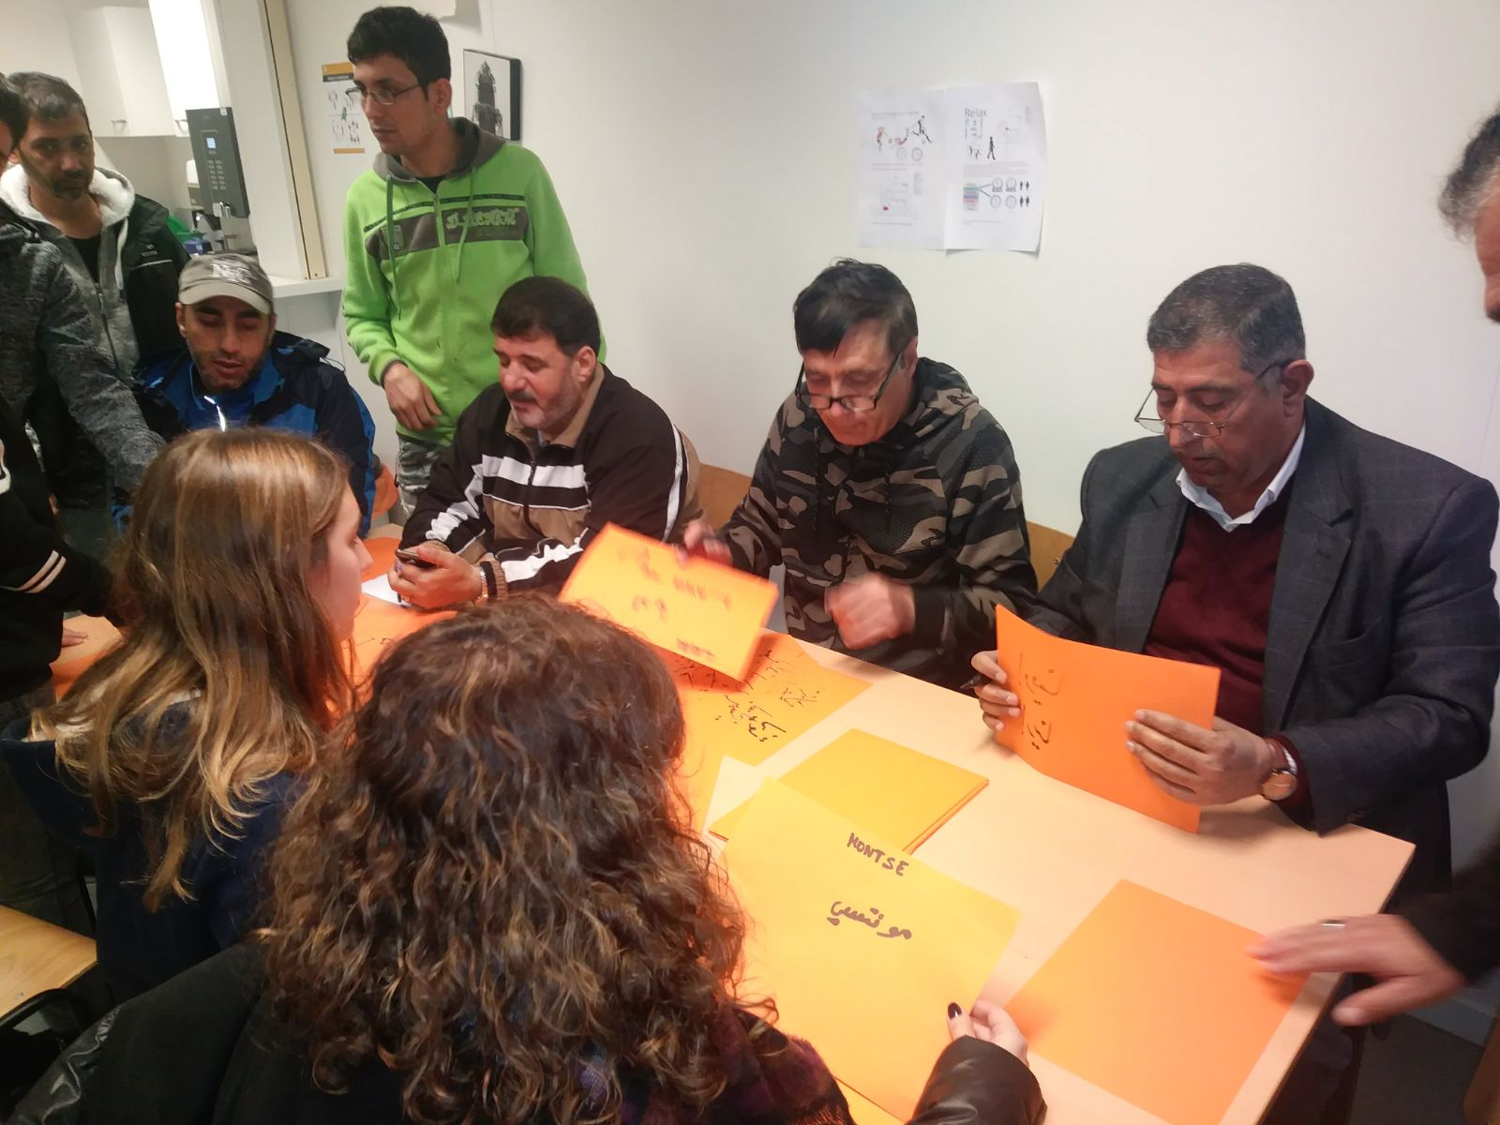
With refugee men…. writing our names in arabic

Slide 27
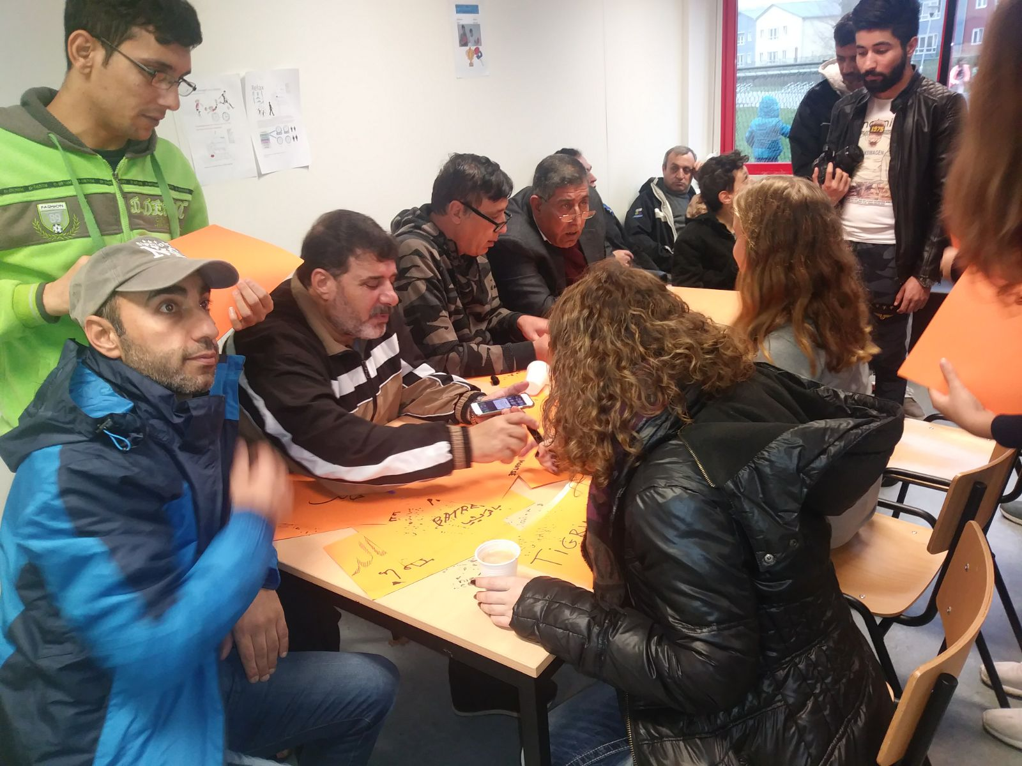

Slide 28
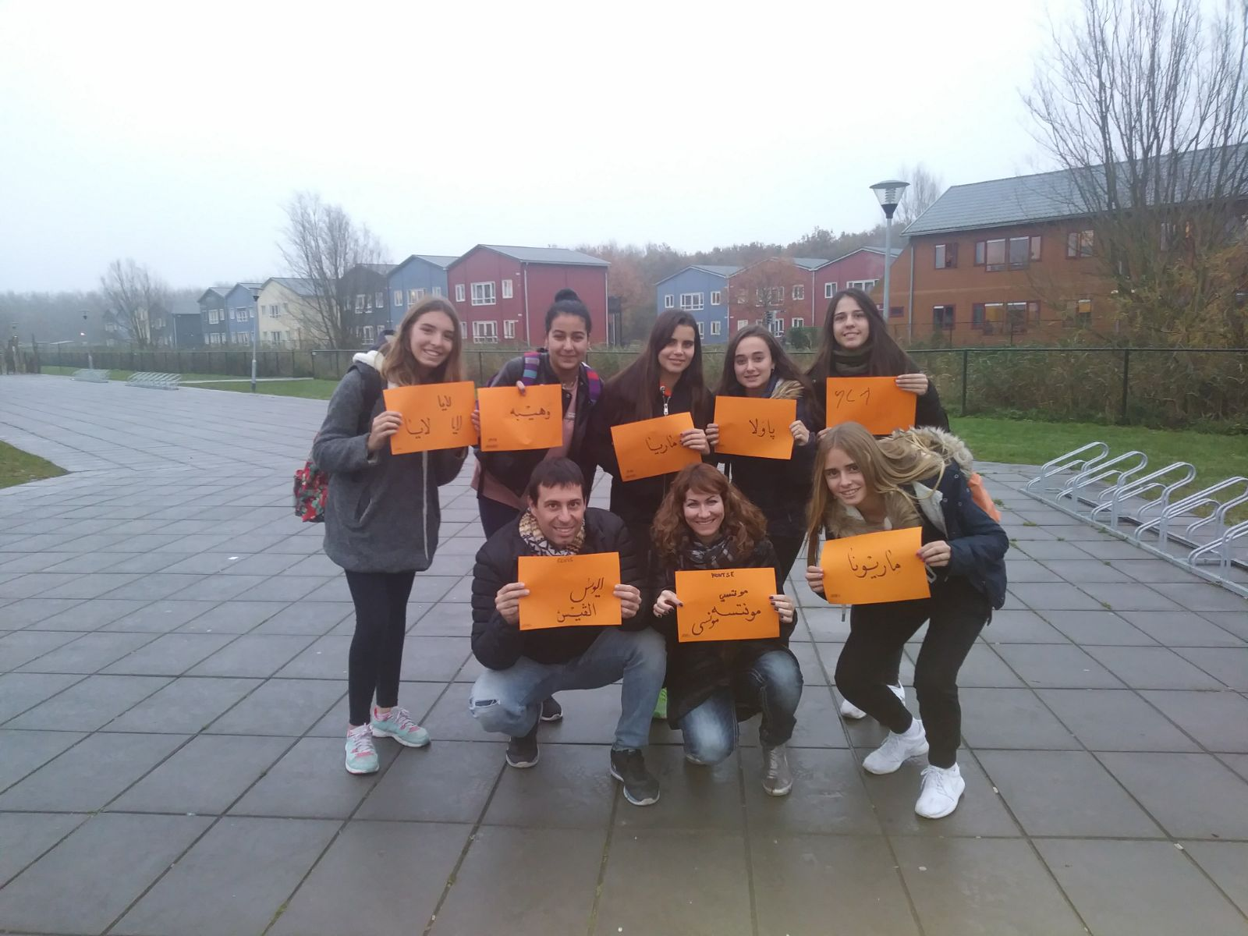
Thanks for this emotional
gift!!

Slide 29
#18D #nooblidem #educacióirefugi

